Slide 1
Artificial Intelligence
Logical Inference
Forward & Backward Chaining
Sec 1: Logic & Entailment
Sec 1 : Reasoning Types
Sec 1 : Expert Systems
Sec 1 : FOL
Sec 1 : Forward Chaining
Sec 1 : Backward Chaining
Lecture 2 | Dr. Husnain Ashfaq

Slide 2
Contents Overview
Logical Inference & Entailment
First-Order Logic (FOL)
Sec 1
Sec 4
Propositions, Connectives, Modus Ponens
Quantifiers, Horn Clauses, Translation
Types of Reasoning
Forward Chaining
Sec 2
Sec 5
Deductive, Inductive, Abductive
Data-Driven Reasoning — 5 Full Examples
Expert Systems
Backward Chaining
Sec 3
Sec 6
Components, Production Rules, Real-World Systems
Goal-Driven Reasoning — 5 Full Examples
Artificial Intelligence | Logical Inference, Forward & Backward Chaining

Slide 3
Section: 1
Logical Inference
& Entailment
Propositions • Connectives • Modus Ponens • Entailment
Artificial Intelligence | Logical Inference, Forward & Backward Chaining

Slide 4
What is Logical Inference?
In everyday life we constantly draw conclusions from available information.
☁️
Dark clouds
🔋
Battery at 2%
🤖
AI Systems
→ It will rain
→ Phone will die soon
→ Must reason the same way
DEFINITION — Logic
Logic is the formal science of correct reasoning. It provides a precise language for expressing knowledge and rules for deriving new true statements from existing ones. In AI, the machine can reason step by step — just like a human expert.
Artificial Intelligence | Logical Inference, Forward & Backward Chaining

Slide 5
Propositions: The Building Blocks
DEFINITION — Proposition
A proposition is any declarative sentence that is either TRUE or FALSE — never both, never neither. A question, command, or opinion is NOT a proposition.
✅ Valid Propositions
❌ NOT Propositions
"It is raining today"
→ TRUE or FALSE. This is a proposition. "Ahmed has a fever"
→ TRUE or FALSE. This is a proposition. "2 + 2 = 4"
→ TRUE. This is a proposition.
"What time is it?"
A question — no truth value. "Please close the door"
A command — no truth value. "This statement is false"
A paradox — violates TRUE/FALSE rule.
Artificial Intelligence | Logical Inference, Forward & Backward Chaining

Slide 6
Logical Connectives
Symbol
Name
Plain English
True When…
¬P
NOT P
NOT P
P is false
P ∧ Q
AND
P AND Q
Both P and Q are true
P ∨ Q
OR
P OR Q
At least one of P, Q is true
P → Q
IF…THEN
IF P THEN Q
FALSE only when P=true but Q=false
P ↔ Q
IFF
P if and only if Q
P and Q have the same truth value
⚠ The Implication (P → Q) is the MOST IMPORTANT connective — every rule in an expert system is an implication!
Artificial Intelligence | Logical Inference, Forward & Backward Chaining

Slide 7
The Implication P → Q (Most Important!)
The implication P → Q is read: "IF P THEN Q". Every rule in an expert system is an implication. Understanding when it is true or false is critical.
P (Condition)
Q (Conclusion)
P → Q Result
What it means
True
True
TRUE ✓
Rule held — condition met, conclusion followed
True
False
FALSE ✗
Rule VIOLATED — condition met but conclusion did NOT follow
False
True
TRUE ✓
Rule not triggered — does not apply
False
False
TRUE ✓
Rule not triggered — same as above
Key: Only FALSE when condition fires (P=true) but conclusion fails (Q=false). All other cases are TRUE.
Artificial Intelligence | Logical Inference, Forward & Backward Chaining

Slide 8
Entailment & Key Inference Rules
DEFINITION — Entailment (KB ⊨ α)
KB entails α if and only if in EVERY possible world where all facts in KB are true, α is also true. α cannot possibly be false if KB is true.
Modus Ponens
Modus Tollens
Hypothetical Syllogism
P → Q , P ⊢ Q
P → Q , ¬Q ⊢ ¬P
P→Q , Q→R ⊢ P→R
If "IF it rains THEN ground is wet" is true, and "It is raining" is true → "The ground is wet". Core of forward chaining.
"IF it rains THEN ground is wet". "Ground is NOT wet". Therefore: "It is NOT raining". The Contrapositive.
"IF smoke THEN fire" and "IF fire THEN alarm". Therefore: "IF smoke THEN alarm". Chains rules together.
Artificial Intelligence | Logical Inference, Forward & Backward Chaining

Slide 9
Activity 1.1 — Identify the Propositions
Identify which of the following are valid propositions and which are not. Explain why for each one.
(a) "All computers in Lab 3 are connected to the internet."
(b) "Is the printer working?"
(c) "Please restart the server."
(d) "If temperature exceeds 100°C, the system shuts down."
(e) "This statement is false."
Artificial Intelligence | Logical Inference, Forward & Backward Chaining

Slide 10
Solution — Activity 1.1
(a) VALID PROPOSITION — It is a declarative sentence: either True or False.
(b) NOT a proposition — It is a question; questions have no truth value.
(c) NOT a proposition — It is a command; commands cannot be True or False.
(d) VALID PROPOSITION — It is a declarative conditional with a clear truth value.
(e) NOT a standard proposition — It is the "Liar Paradox". If it is true it is false, and vice versa — it violates the rule that a proposition must be unambiguously True or False.
Artificial Intelligence | Logical Inference, Forward & Backward Chaining

Slide 11
Activity 1.2 — Calculate Truth Values
Given: P = TRUE and Q = FALSE
Calculate the truth value of each expression and explain your reasoning:
(a) ¬P
(b) P ∧ Q
(c) P ∨ Q
(d) P → Q
(e) Q → P
Artificial Intelligence | Logical Inference, Forward & Backward Chaining

Slide 12
Solution — Activity 1.2
(a) ¬P = ¬TRUE = FALSE
(b) P ∧ Q = TRUE ∧ FALSE = FALSE (both must be true; Q is false)
(c) P ∨ Q = TRUE ∨ FALSE = TRUE (at least one is true; P is true)
(d) P → Q = TRUE → FALSE = FALSE (condition TRUE but conclusion FALSE — rule VIOLATED)
(e) Q → P = FALSE → TRUE = TRUE (condition is FALSE — rule is never triggered, so it holds)
⚠ Key Insight: (d) is FALSE but (e) is TRUE. The DIRECTION of an implication matters enormously!
Artificial Intelligence | Logical Inference, Forward & Backward Chaining

Slide 13
Activity 1.3 — Apply Modus Ponens
Apply the inference rules step by step:
Rule 1: IF a vehicle has no fuel THEN it will not start.
Rule 2: IF a vehicle will not start THEN the driver will be late.
Fact: Sara's car has no fuel.
Using Hypothetical Syllogism followed by Modus Ponens, what can you conclude about Sara?
Artificial Intelligence | Logical Inference, Forward & Backward Chaining

Slide 14
Solution — Activity 1.3
Step 1 — Apply Hypothetical Syllogism:
Rule 1: NoFuel → WillNotStart
Rule 2: WillNotStart → DriverLate
Combined: NoFuel → DriverLate (new derived rule)
Step 2 — Apply Modus Ponens:
We have: NoFuel → DriverLate (from Step 1)
We know: NoFuel(Sara) is TRUE (given fact)
Therefore: DriverLate(Sara) is TRUE
Conclusion: Sara will be late.
Artificial Intelligence | Logical Inference, Forward & Backward Chaining

Slide 15
Section 2
Types of Reasoning
Deductive • Inductive • Abductive
Artificial Intelligence | Logical Inference, Forward & Backward Chaining

Slide 16
Three Types of Reasoning
⚙️ Deductive
🔬 Inductive
💡 Abductive
General rules + specific facts → Guaranteed specific conclusion
Many specific observations → Probable general rule
Observation → Most likely explanation
Example:
Example:
Example:
All humans are mortal. Socrates is human. ∴ Socrates is mortal.
Observed 1000 white swans → concluded all swans are white (then found a black one!)
Grass is wet → It probably rained (could be a sprinkler — best guess only)
AI Use: Expert systems, logic engines
Certainty: 100% guaranteed
AI Use: Machine learning, neural nets
Certainty: Probable only
AI Use: Medical diagnosis, NLP
Certainty: Best guess
Artificial Intelligence | Logical Inference, Forward & Backward Chaining

Slide 17
Comparison Table
Feature
Deductive
Inductive
Abductive
Starting point
General rules
Specific examples
An observation
Goal
Specific conclusion
General rule
Best explanation
Certainty
100% guaranteed
Probable only
Best guess
AI Use
Expert systems, logic
ML, neural nets
Diagnosis, NLP
Artificial Intelligence | Logical Inference, Forward & Backward Chaining

Slide 18
Activity 2.1 — Classify the Reasoning
Classify each scenario as Deductive, Inductive, or Abductive. Give a one-sentence justification.
(a) A student observes that every time he studies the night before, he fails the test.
He concludes: "Studying the night before causes failure."
(b) The rule says: "All students who miss 3 or more classes are barred from the exam."
Zara has missed 4 classes. Therefore Zara is barred.
(c) The server response time is 8 seconds (normally 0.2 seconds).
You conclude: "The database must be overloaded."
Artificial Intelligence | Logical Inference, Forward & Backward Chaining

Slide 19
Solution — Activity 2.1
(a) INDUCTIVE — He is observing repeated specific instances and forming a general rule. The conclusion is probable, not certain.
(b) DEDUCTIVE — He is applying a known general rule to a specific verified fact. The conclusion is 100% guaranteed.
(c) ABDUCTIVE — He is given an observation (slow response) and proposing the BEST EXPLANATION (overloaded database). Other explanations exist but this is most plausible.
Artificial Intelligence | Logical Inference, Forward & Backward Chaining

Slide 20
Activity 2.2 — Traffic System Analysis
A city traffic system has the rule:
"IF road_blocked AND alternative_route_available THEN divert_traffic."
The system observes:
— Road_A is blocked
— No alternative route is available
(a) Which reasoning type does this system use?
(b) Does the rule fire? Construct the truth table for this implication.
(c) What is the LIMITATION of abductive reasoning compared to this system?
Artificial Intelligence | Logical Inference, Forward & Backward Chaining

Slide 21
✅ Solution — Activity 2.2
(a) DEDUCTIVE reasoning — the system applies a known IF-THEN rule to specific facts.
(b) Road_Blocked(A) = TRUE, AlternativeRoute = FALSE
TRUE ∧ FALSE = FALSE — the conjunction is FALSE, so the rule does NOT fire.
The system does NOT divert traffic because no alternative is available.
(c) Abductive reasoning gives the BEST GUESS, not a guaranteed conclusion.
Deductive reasoning gives CERTAIN outcomes given verified facts.
Artificial Intelligence | Logical Inference, Forward & Backward Chaining

Slide 22
Section 3
Expert Systems
Rule-Based Systems • Production Rules • Real-World Applications
Artificial Intelligence | Logical Inference, Forward & Backward Chaining

Slide 23
What is an Expert System?
DEFINITION — Expert System
An expert system is an AI program that captures the knowledge and reasoning ability of a human expert in a specific domain. It uses a Knowledge Base (what the expert knows) and an Inference Engine (how the expert thinks) to answer questions — even without the human expert present.
1
Knowledge Base
2
Inference Engine
3
Explanation Module
Stores FACTS (known truths) and RULES (IF-THEN expert knowledge). Also maintains Working Memory — a dynamic store of everything currently known.
The "thinking" part. Scans the KB for rules whose conditions are satisfied, fires them to derive new facts, and repeats until a goal is reached.
Explains WHY the system reached a conclusion by tracing which rules fired. Critical in medicine, law, and finance — accountability matters.
Artificial Intelligence | Logical Inference, Forward & Backward Chaining

Slide 24
Production Rules & Famous Expert Systems
Production Rule Format
IF <condition1> AND <condition2> AND … THEN <conclusion>
This is the standard format for encoding expert knowledge as machine-executable rules.
System
Year
Domain
Achievement
MYCIN
1976
Medicine
Diagnosed blood infections using 600 rules. Performed as well as specialist physicians.
XCON
1980
Engineering
Configured DEC VAX computers using 10,000+ rules. Saved $40 million per year.
DENDRAL
1969
Chemistry
Identified molecular structures from spectrometer data. First major AI success story.
Artificial Intelligence | Logical Inference, Forward & Backward Chaining

Slide 25
Activity 3.1 — Academic Probation Expert System
A university expert system decides if a student should be placed on academic probation:
Rules:
R1: IF GPA < 2.0 AND FailedSubjects > 2 THEN OnProbation
R2: IF OnProbation AND MissedOrientation THEN Expelled
Student Record: GPA = 1.7 | Failed subjects = 3 | Attended orientation = NO
Write the production rules in FOL, list the facts, then trace what conclusions the inference engine reaches.
Artificial Intelligence | Logical Inference, Forward & Backward Chaining

Slide 26
Solution — Activity 3.1
RULES:
R1: IF LowGPA(x) ∧ FailedMultiple(x) → OnProbation(x)
R2: IF OnProbation(x) ∧ MissedOrientation(x) → Expelled(x)
FACTS: LowGPA(student) | FailedMultiple(student) | MissedOrientation(student)
TRACE:
Pass 1: R1 checks — LowGPA ✓ AND FailedMultiple ✓ → R1 FIRES → OnProbation(student) added
Pass 2: R2 checks — OnProbation ✓ AND MissedOrientation ✓ → R2 FIRES → Expelled(student) added
Pass 3: No more rules can fire. STOP.
CONCLUSION: The student is EXPELLED.
Artificial Intelligence | Logical Inference, Forward & Backward Chaining

Slide 27
🔍 Activity 3.2 — Expert System vs Neural Network
Explain why an expert system is MORE SUITABLE than a neural network for a hospital medication approval system.
Use the 3 components of an expert system in your answer.
(Think about when you NEED to explain WHY a decision was made — accountability and auditability are key.)
Artificial Intelligence | Logical Inference, Forward & Backward Chaining

Slide 28
✅ Solution — Activity 3.2
1. Knowledge Base: Rules written explicitly by medical experts (e.g., "IF drug A AND drug B THEN fatal_interaction").
Doctors can review, verify, and update the exact rules being used.
2. Inference Engine: Each decision is traced through specific rules. If the system says "Do not prescribe X",
it is because Rule 7 fired, requiring condition Y and Z.
3. Explanation Module: Tells the pharmacist EXACTLY why it flagged an interaction. A neural network outputs
a probability but CANNOT explain.
Why neural networks are unsuitable: (a) black boxes — no explanation, (b) may lack training data for rare interactions,
(c) a wrong decision cannot be easily corrected.
Conclusion: In life-critical domains, expert systems are the correct choice.
Artificial Intelligence | Logical Inference, Forward & Backward Chaining

Slide 29
Section 4
First-Order Logic (FOL)
Quantifiers • Predicates • Horn Clauses • Translation Practice
Artificial Intelligence | Logical Inference, Forward & Backward Chaining

Slide 30
Why FOL? Core Components
With simple propositional logic, you need separate statements per person: "Ahmed-has-fever", "Sara-has-fever". With FOL, write Fever(x) once — x stands for any person.
Component
Example
What it means
Constants
Ahmed, London, 42
Specific named objects in the world
Variables
x, y, z
Placeholders — can stand for any object
Predicates
Fever(x), Loves(x,y)
Properties of objects, or relationships between them
∀x (For All)
∀x Human(x)→Mortal(x)
The statement is true for EVERY object x
∃x (There Exists)
∃x Student(x)∧Smart(x)
There is AT LEAST ONE object x satisfying this
Artificial Intelligence | Logical Inference, Forward & Backward Chaining

Slide 31
The Critical Quantifier Rule (MEMORISE)
⚠ MEMORISE THIS
Use ∀ (for all) with → (implication)
Use ∃ (there exists) with ∧ (AND)
This is the most common mistake students make in exams.
✅ CORRECT
✅ CORRECT
❌ WRONG
∀x Human(x) → Mortal(x)
∃x Student(x) ∧ Smart(x)
∀x Human(x) ∧ Mortal(x)
Every human is mortal
Some student is smart
Every object is BOTH human AND mortal — incorrect!
Artificial Intelligence | Logical Inference, Forward & Backward Chaining

Slide 32
English → FOL Translation Practice
English Sentence
FOL Formula
Key Rule
Every student studies
∀x Student(x) → Studies(x)
∀ with →
Some students are hardworking
∃x Student(x) ∧ Hardworking(x)
∃ with ∧
No dog can fly
∀x Dog(x) → ¬CanFly(x)
∀ + NOT in conclusion
Every patient with fever & cough has flu
∀x [Fever(x) ∧ Cough(x)] → Flu(x)
∀ + compound condition
Only doctors can prescribe
∀x Prescribes(x) → Doctor(x)
"Only A does B" = If B then A
Artificial Intelligence | Logical Inference, Forward & Backward Chaining

Slide 33
Horn Clauses: FOL in Rule Engines
DEFINITION — Horn Clause
A Horn Clause has at most ONE positive conclusion (the head) and any number of conditions (the body).
Format: Head ← Body1 ∧ Body2 ∧ … ∧ BodyN
Both Prolog and CLIPS use Horn Clauses because they make reasoning efficient and decidable.
Fact (unconditionally true)
Rule (head ← body)
Employed(Ahmed) ←
(No body — always true regardless of situation)
EligibleForLoan(x) ←
Employed(x)
∧ AgeOver21(x)
∧ GoodCredit(x)
Artificial Intelligence | Logical Inference, Forward & Backward Chaining

Slide 34
🔍 Activity 4.1 — English to FOL Translation
Translate each sentence into a correct FOL formula. State which quantifier you used and why.
(a) Every registered voter must be over 18.
(b) Some employees earn a bonus.
(c) No machine can think.
(d) Every employee who works overtime and has good reviews gets a raise.
(e) At least one student passed all 5 subjects.
Artificial Intelligence | Logical Inference, Forward & Backward Chaining

Slide 35
Solution — Activity 4.1
(a) ∀x RegisteredVoter(x) → Over18(x) Used ∀ with → : IF registered voter THEN over 18.
(b) ∃x Employee(x) ∧ EarnsBonus(x) Used ∃ with ∧ : "some" means at least one.
(c) ∀x Machine(x) → ¬CanThink(x) Used ∀ with → and negation. "No machine" = "every machine does NOT".
(d) ∀x [Employee(x) ∧ WorksOvertime(x) ∧ GoodReviews(x)] → GetsRaise(x)
Used ∀ with compound condition — multiple conditions joined with ∧.
(e) ∃x Student(x) ∧ PassedAll5(x) Used ∃ with ∧. "At least one" is existential.
Artificial Intelligence | Logical Inference, Forward & Backward Chaining

Slide 36
Activity 4.2 — Smart Home Horn Clauses
Write the following in Horn Clause format:
"If motion is detected and it is night time and the alarm is armed, then trigger the alarm."
"The alarm is armed." (a fixed fact)
"It is night time." (a fixed fact)
Then show how the inference engine derives new facts when MotionDetected(Room3) is received.
Artificial Intelligence | Logical Inference, Forward & Backward Chaining

Slide 37
Solution — Activity 4.2
HORN CLAUSES:
Fact 1: AlarmArmed ← (no body — unconditionally true)
Fact 2: NightTime ← (no body — unconditionally true)
Rule: TriggerAlarm(r) ← MotionDetected(r) ∧ NightTime ∧ AlarmArmed
INFERENCE TRACE:
WM starts: { AlarmArmed, NightTime }
Sensor sends: MotionDetected(Room3)
WM becomes: { AlarmArmed, NightTime, MotionDetected(Room3) }
Rule check: MotionDetected(Room3) ✓ NightTime ✓ AlarmArmed ✓
All 3 met → Rule FIRES → TriggerAlarm(Room3) added
CONCLUSION: The alarm is triggered for Room 3.
Artificial Intelligence | Logical Inference, Forward & Backward Chaining

Slide 38
Section 5
Forward Chaining
Data-Driven Reasoning • 5 Full Examples
Artificial Intelligence | Logical Inference, Forward & Backward Chaining

Slide 39
Forward Chaining: Definition & Algorithm
DEFINITION — Forward Chaining
Starts with KNOWN FACTS and keeps applying rules to derive NEW facts, until either a goal is reached or no more rules can fire. It asks: "Given what I already know, what NEW things can I figure out?" Works forward from DATA to CONCLUSIONS.
MATCH
FIRE
1
Look at every rule. Check whether ALL conditions of that rule are currently in Working Memory.
3
Apply the selected rule. Write its conclusion as a NEW FACT in Working Memory.
SELECT
TERMINATE?
2
From rules whose conditions are all satisfied (the conflict set), pick one to fire.
4
Goal reached → STOP. No new facts added → FIXPOINT → STOP. Otherwise go to Step 1.
Artificial Intelligence | Logical Inference, Forward & Backward Chaining

Slide 40
Critical Skill: Identifying Rules vs Facts
CRITICAL SKILL
Before you can do forward or backward chaining, you must know HOW to extract rules and facts from a real-world description.
📋 RULE
📌 FACT
A conditional relationship between two or more things. Applies to CATEGORIES of objects — uses VARIABLES (x).
Test: "Does this apply to EVERY X in a category?" → RULE
Example: "IF an animal has fur AND gives milk THEN it is a mammal"
A specific piece of known information about a specific individual. Uses CONSTANTS (specific names). Facts are GIVEN — not derived.
Test: "Is this about a specific NAMED individual?" → FACT
Example: "The animal has fur" (about THIS animal specifically)
Artificial Intelligence | Logical Inference, Forward & Backward Chaining

Slide 41
Example 5.1: Animal Classification
📋 PROBLEM STATEMENT
We observe an unknown animal. The animal has fur on its body, produces milk to feed its young, and has black and orange stripes on its body.
Based on biological classification knowledge, determine what type of animal this is.
Artificial Intelligence | Logical Inference, Forward & Backward Chaining

Slide 42
Ex 5.1 (Animal) — Step 1: Extract Facts & Rules
Item
Type
Reason for Classification
The animal has fur
FACT
Specific observation about THIS animal. Describes a concrete property of one individual.
The animal produces milk
FACT
Specific observation about this specific individual animal. Directly given.
The animal has stripes
FACT
Directly observed property of this specific animal. Given, not derived.
IF HasFur AND GivesMilk THEN Mammal
RULE
General biological principle applying to ALL animals — uses variable x.
IF Mammal AND HasStripes THEN Tiger
RULE
General biological rule applicable to any mammal with stripes. Category-level conditional.
Artificial Intelligence | Logical Inference, Forward & Backward Chaining

Slide 43
Ex 5.1 (Animal) — Step 2: FOL Representation
FOL Rules
Facts & Initial WM
R1: ∀x HasFur(x) ∧ GivesMilk(x)
→ Mammal(x)
"For every animal x: if x has
fur AND gives milk → mammal"
R2: ∀x Mammal(x) ∧ HasStripes(x)
→ Tiger(x)
"For every animal x: if x is a
mammal AND has stripes → tiger"
F1: HasFur(animal)
F2: GivesMilk(animal)
F3: HasStripes(animal)
Initial WM:
{ HasFur, GivesMilk, HasStripes }
Artificial Intelligence | Logical Inference, Forward & Backward Chaining

Slide 44
Ex 5.1 (Animal) — Forward Chaining Trace
Pass 1
Check R1
R1: HasFur(animal) ✓ GivesMilk(animal) ✓
BOTH satisfied. R1 FIRES.
→ NEW FACT: Mammal(animal) added.
WM = { HasFur, GivesMilk, HasStripes, Mammal }
Pass 2
Check R2
R2: Mammal(animal) ✓ (just derived) HasStripes(animal) ✓
BOTH satisfied. R2 FIRES.
→ NEW FACT: Tiger(animal) added.
WM = { HasFur, GivesMilk, HasStripes, Mammal, Tiger }
Pass 3
Fixpoint
Rescan all rules: R1 → Mammal already in WM. R2 → Tiger already in WM.
No rule can add any new fact. FIXPOINT REACHED. STOP.
Artificial Intelligence | Logical Inference, Forward & Backward Chaining

Slide 45
Ex 5.1 (Animal) — Conclusion
✅ CONCLUSION
The animal is a TIGER.
Chain: HasFur + GivesMilk → Mammal (Pass 1, R1 fires)
Mammal + HasStripes → Tiger (Pass 2, R2 fires)
Key Insight: R2 could NOT fire until R1 first derived "Mammal". Derived facts unlock further rules — that is the essence of forward chaining.
Artificial Intelligence | Logical Inference, Forward & Backward Chaining

Slide 46
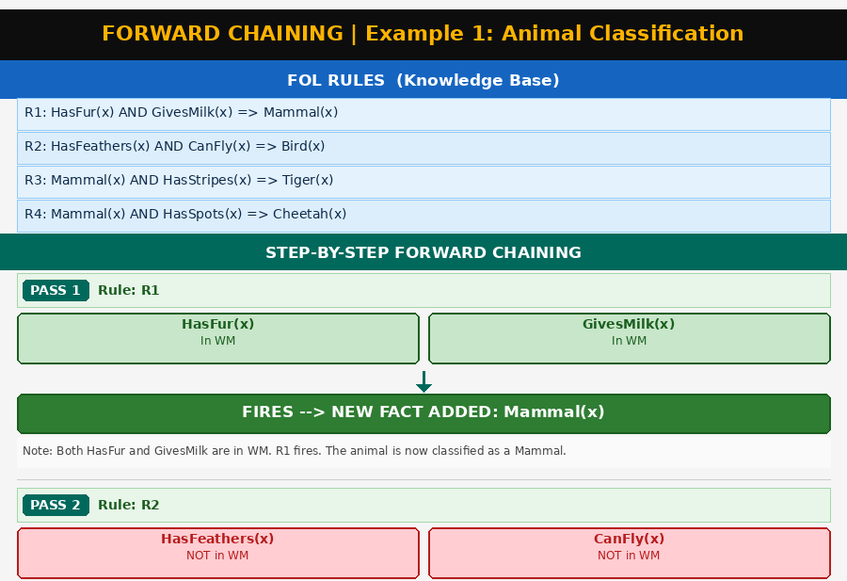
Ex 5.1 (Animal) — Forward Chaining Diagram (Part 1 of 2)
Artificial Intelligence | Logical Inference, Forward & Backward Chaining

Slide 47
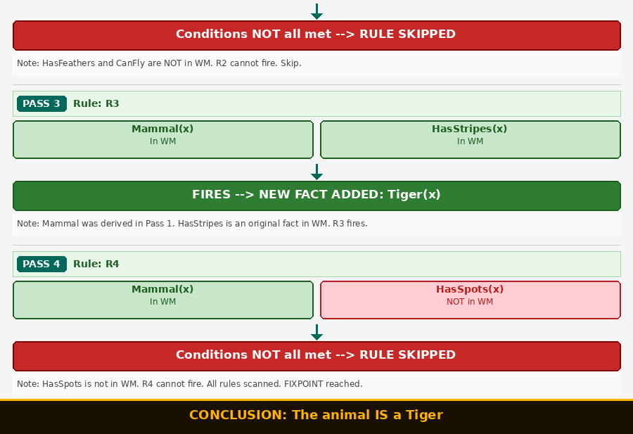
Ex 5.1 (Animal) — Forward Chaining Diagram (Part 2 of 2)
Artificial Intelligence | Logical Inference, Forward & Backward Chaining

Slide 48
Example 5.2: Medical Diagnosis
📋 PROBLEM STATEMENT
A patient named Ahmed visits a clinic. The doctor observes: high fever, coughing, and sharp chest pain.
Medical knowledge:
• Any patient with fever and cough has an infection.
• If a patient has an infection and also chest pain, the infection is serious.
• Any patient with a serious infection must be hospitalized.
• If a patient has fever and a rash, that indicates an allergy.
Artificial Intelligence | Logical Inference, Forward & Backward Chaining

Slide 49
Ex 5.2 (Medical) — Step 1: Extract Facts & Rules
Item
Type
Reason for Classification
Ahmed has a high fever
FACT
Directly observed about this specific patient. Uses the constant 'Ahmed'.
Ahmed is coughing
FACT
Specific clinical observation about Ahmed. Given, not derived.
Ahmed has chest pain
FACT
Specific symptom observed in this specific patient. Given.
IF fever AND cough THEN infection
RULE
General medical principle applying to ANY patient. Uses variable p.
IF infection AND chest pain THEN serious
RULE
General medical rule applicable to any patient with these conditions.
IF serious infection THEN hospitalize
RULE
General medical protocol for any patient with a serious infection.
IF fever AND rash THEN allergy
RULE
General rule — Ahmed has NO rash, so this will NOT fire.
Artificial Intelligence | Logical Inference, Forward & Backward Chaining

Slide 50
Ex 5.2 (Medical) — Step 2: FOL Representation
FOL Rules
Facts & Initial WM
R1: ∀p Fever(p) ∧ Cough(p)
→ Infection(p)
R2: ∀p Infection(p) ∧ ChestPain(p)
→ SeriousInfection(p)
R3: ∀p SeriousInfection(p)
→ Hospitalize(p)
R4: ∀p Fever(p) ∧ Rash(p)
→ Allergy(p)
F1: Fever(Ahmed)
F2: Cough(Ahmed)
F3: ChestPain(Ahmed)
(Rash — NOT given, R4 won't fire)
Initial WM:
{ Fever, Cough, ChestPain }
Artificial Intelligence | Logical Inference, Forward & Backward Chaining

Slide 51
Ex 5.2 (Medical) — Forward Chaining Trace
Pass 1
Check R1
R1: Fever(Ahmed) ✓ Cough(Ahmed) ✓
R1 FIRES. → NEW FACT: Infection(Ahmed) added.
WM = { Fever, Cough, ChestPain, Infection }
Pass 1
R2,R3,R4
R2: Infection not yet in WM at start of pass. CANNOT FIRE.
R3: SeriousInfection not in WM. Cannot fire.
R4: Rash(Ahmed) not in WM. Cannot fire.
Pass 2
Check R2
R2: Infection(Ahmed) ✓ (derived in Pass 1) ChestPain(Ahmed) ✓
R2 FIRES. → NEW FACT: SeriousInfection(Ahmed) added.
Pass 3
Check R3
R3: SeriousInfection(Ahmed) ✓ (derived in Pass 2)
R3 FIRES. → NEW FACT: Hospitalize(Ahmed) added.
Artificial Intelligence | Logical Inference, Forward & Backward Chaining

Slide 52
Ex 5.2 (Medical) — Forward Chaining Trace
Pass 4
Fixpoint
All rules rescanned. No rule can add any new fact. R4 still cannot fire.
FIXPOINT REACHED. STOP.
Artificial Intelligence | Logical Inference, Forward & Backward Chaining

Slide 53
Ex 5.2 (Medical) — Conclusion
✅ CONCLUSION
Ahmed must be HOSPITALIZED.
Chain: Fever + Cough → Infection (Pass 1)
Infection + ChestPain → SeriousInfection (Pass 2)
SeriousInfection → Hospitalize (Pass 3)
Note: R4 (Allergy rule) was in the Knowledge Base but NEVER fired — no Rash fact existed.
Artificial Intelligence | Logical Inference, Forward & Backward Chaining

Slide 54
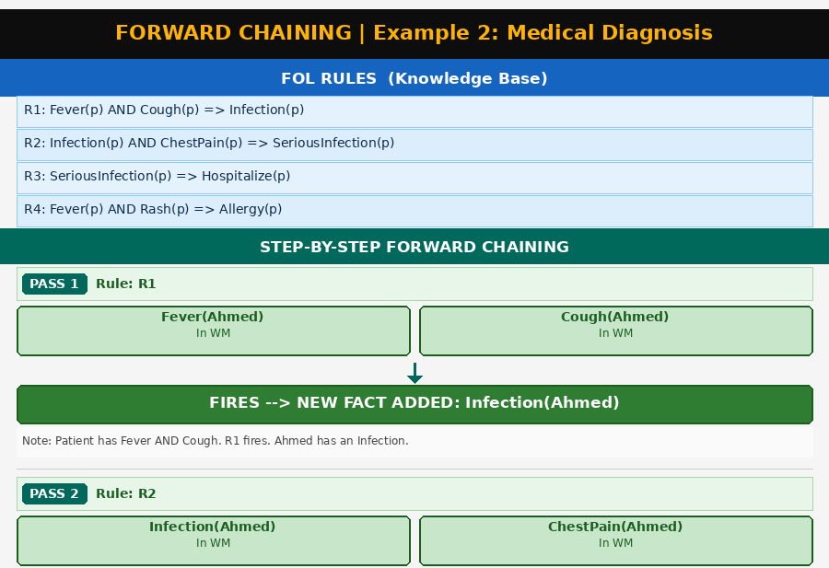
Ex 5.2 (Medical) — Forward Chaining Diagram (Part 1 of 2)

Slide 55
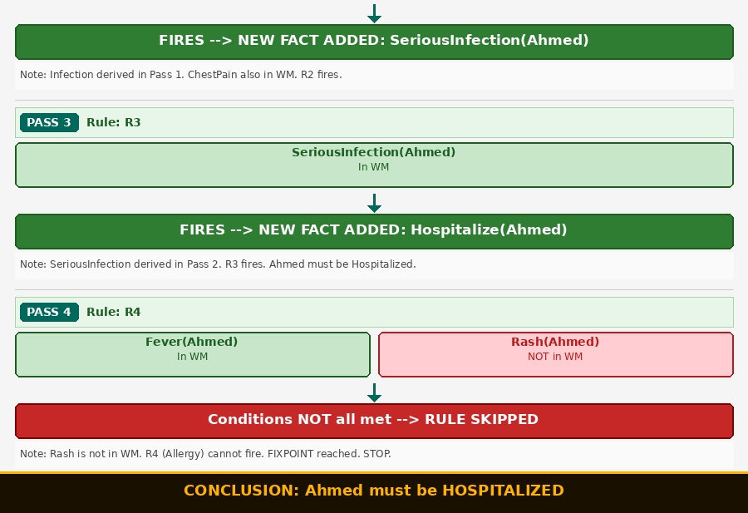
Ex 5.2 (Medical) — Forward Chaining Diagram (Part 2 of 2)
Artificial Intelligence | Logical Inference, Forward & Backward Chaining

Slide 56
Example 5.3: Loan Eligibility
📋 PROBLEM STATEMENT
A bank processes a loan application for Sara. Sara is employed, 27 years old (over 21), has good credit, and earns PKR 1,800,000 annually (above the PKR 600,000 threshold).
Bank policy: employed + over21 → basically eligible. basically eligible + good credit → fully eligible. fully eligible + high income → premium loan. basically eligible + NO good credit → micro loan only.
Artificial Intelligence | Logical Inference, Forward & Backward Chaining

Slide 57
Ex 5.3 (Loan) — Step 1: Extract Facts & Rules
Item
Type
Reason for Classification
Sara is employed
FACT
Specific verified information about the individual Sara. Named constant.
Sara is over 21
FACT
Age verified for this specific person. Given evidence.
Sara has good credit
FACT
Specific verified credit record attribute for Sara.
Sara earns over threshold
FACT
Specific financial fact about Sara. Verified income figure.
IF Employed AND AgeOver21 THEN BasicEligible
RULE
Bank policy applying to ANY applicant. Uses variable x.
IF BasicEligible AND GoodCredit THEN FullEligible
RULE
General bank policy applicable to any applicant.
IF FullEligible AND HighIncome THEN PremiumLoan
RULE
General eligibility tier rule for any customer.
IF BasicEligible AND NOT GoodCredit THEN MicroLoan
RULE
Alternative pathway — will NOT fire because Sara HAS good credit.
Artificial Intelligence | Logical Inference, Forward & Backward Chaining

Slide 58
Ex 5.3 (Loan) — Step 2: FOL Representation
FOL Rules
Facts & Initial WM
R1: ∀x Employed(x) ∧ AgeOver21(x)
→ BasicEligible(x)
R2: ∀x BasicEligible(x) ∧ GoodCredit(x)
→ FullEligible(x)
R3: ∀x FullEligible(x) ∧ IncomeHigh(x)
→ PremiumLoan(x)
R4: ∀x BasicEligible(x) ∧ ¬GoodCredit(x)
→ MicroLoanOnly(x)
F1: Employed(Sara)
F2: AgeOver21(Sara)
F3: GoodCredit(Sara)
F4: IncomeHigh(Sara)
(GoodCredit present → R4 blocked)
Initial WM:
{ Employed, AgeOver21,
GoodCredit, IncomeHigh }
Artificial Intelligence | Logical Inference, Forward & Backward Chaining

Slide 59
Ex 5.3 (Loan) — Forward Chaining Trace
Pass 1
Check R1
R1: Employed(Sara) ✓ AgeOver21(Sara) ✓
R1 FIRES. → NEW FACT: BasicEligible(Sara) added.
Pass 2
Check R2
R2: BasicEligible(Sara) ✓ (derived) GoodCredit(Sara) ✓
R2 FIRES. → NEW FACT: FullEligible(Sara) added.
Pass 2
Check R4
R4: BasicEligible ✓ BUT ¬GoodCredit(Sara) is FALSE (Sara HAS good credit).
Negation condition fails. R4 CANNOT FIRE.
Pass 3
Check R3
R3: FullEligible(Sara) ✓ (derived) IncomeHigh(Sara) ✓
R3 FIRES. → NEW FACT: PremiumLoan(Sara) added.
Artificial Intelligence | Logical Inference, Forward & Backward Chaining

Slide 60
Ex 5.3 (Loan) — Forward Chaining Trace
Pass 4
Fixpoint
No new facts can be derived. FIXPOINT REACHED. STOP.
Artificial Intelligence | Logical Inference, Forward & Backward Chaining

Slide 61
Ex 5.3 (Loan) — Conclusion
✅ CONCLUSION
Sara qualifies for a PREMIUM LOAN.
Chain: Employed + AgeOver21 → BasicEligible (R1)
BasicEligible + GoodCredit → FullEligible (R2)
FullEligible + IncomeHigh → PremiumLoan (R3)
R4 was blocked because Sara has good credit — the negation ¬GoodCredit was false.
Artificial Intelligence | Logical Inference, Forward & Backward Chaining

Slide 62
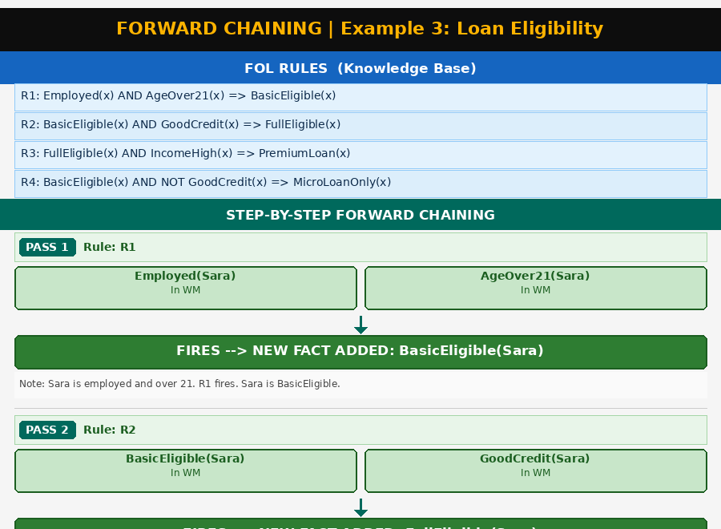
Ex 5.3 (Loan) — Forward Chaining Diagram (Part 1 of 2)

Slide 63
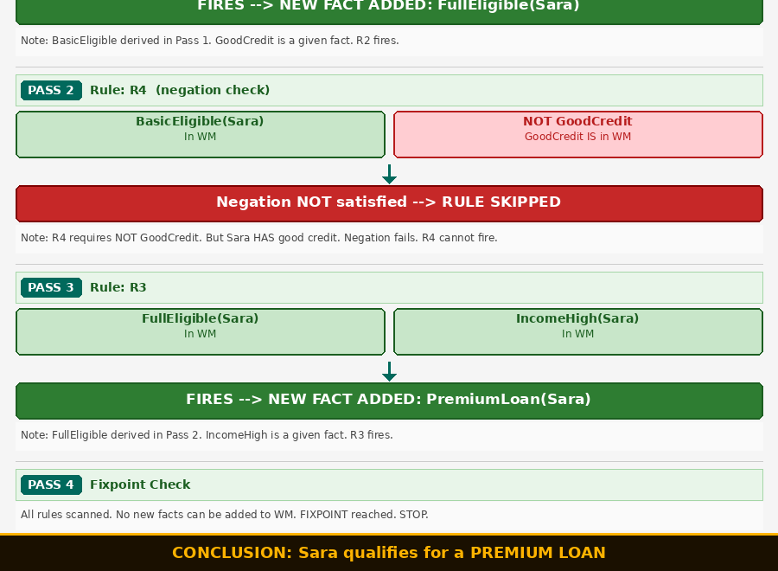
Ex 5.3 (Loan) — Forward Chaining Diagram (Part 2 of 2)
Artificial Intelligence | Logical Inference, Forward & Backward Chaining

Slide 64
Example 5.4: Student Scholarship
📋 PROBLEM STATEMENT
A university evaluates student Ali. Ali scored 91 in his final exam and has good attendance.
University policy: score ≥ 85 → high achiever. high achiever + good attendance → distinction. distinction + needs-based → scholarship. distinction + NOT needs-based → merit award.
Ali has NOT applied for needs-based support.
Artificial Intelligence | Logical Inference, Forward & Backward Chaining

Slide 65
Ex 5.4 (Scholarship) — Step 1: Extract Facts & Rules
Item
Type
Reason for Classification
Ali scored 91
FACT
Specific exam result for Ali. A concrete measured value. Given data.
Ali has good attendance
FACT
Specific attendance record for Ali. A named individual's attribute.
Ali is NOT needs-based
FACT
Absence of needs-based application for this specific student.
IF score ≥ 85 THEN HighAchiever
RULE
General university policy for ALL students. Uses variable x and a threshold.
IF HighAchiever AND GoodAttendance THEN Distinction
RULE
Another general policy applying to any student. Uses a variable.
IF Distinction AND NeedsBased THEN Scholarship
RULE
General award rule — NeedsBased must be a fact for this student.
IF Distinction AND NOT NeedsBased THEN MeritAward
RULE
Alternative award rule. The negation ¬NeedsBased will be satisfied for Ali.
Artificial Intelligence | Logical Inference, Forward & Backward Chaining

Slide 66
Ex 5.4 (Scholarship) — Step 2: FOL Representation
FOL Rules
Facts & Initial WM
R1: ∀x Score(x,s) ∧ s≥85
→ HighAchiever(x)
R2: ∀x HighAchiever(x) ∧ GoodAttend(x)
→ Distinction(x)
R3: ∀x Distinction(x) ∧ NeedsBased(x)
→ Scholarship(x)
R4: ∀x Distinction(x) ∧ ¬NeedsBased(x)
→ MeritAward(x)
F1: Score(Ali, 91)
F2: GoodAttend(Ali)
NeedsBased(Ali) NOT in WM
Initial WM:
{ Score(Ali,91), GoodAttend(Ali) }
Artificial Intelligence | Logical Inference, Forward & Backward Chaining

Slide 67
Ex 5.4 (Scholarship) — Forward Chaining Trace
Pass 1
Check R1
R1: Score(Ali,91) ✓ AND 91≥85 ✓
R1 FIRES. → NEW FACT: HighAchiever(Ali) added.
Pass 2
Check R2
R2: HighAchiever(Ali) ✓ (derived) GoodAttend(Ali) ✓
R2 FIRES. → NEW FACT: Distinction(Ali) added.
Pass 3
R3 vs R4
R3: Distinction(Ali) ✓ NeedsBased(Ali) ✗ — NOT in WM. R3 CANNOT FIRE.
R4: Distinction(Ali) ✓ ¬NeedsBased(Ali) ✓ (absent → negation TRUE)
R4 FIRES. → NEW FACT: MeritAward(Ali) added.
Pass 4
Fixpoint
No more rules can fire. FIXPOINT REACHED. STOP.
Artificial Intelligence | Logical Inference, Forward & Backward Chaining

Slide 68
Ex 5.4 (Scholarship) — Conclusion
✅ CONCLUSION
Ali receives a MERIT AWARD (not a scholarship).
Chain: Score(91) ≥ 85 → HighAchiever (R1)
HighAchiever + GoodAttend → Distinction (R2)
Distinction + ¬NeedsBased → MeritAward (R4)
R3 was blocked because NeedsBased was never a fact for Ali. R4 fired instead.
Artificial Intelligence | Logical Inference, Forward & Backward Chaining

Slide 69
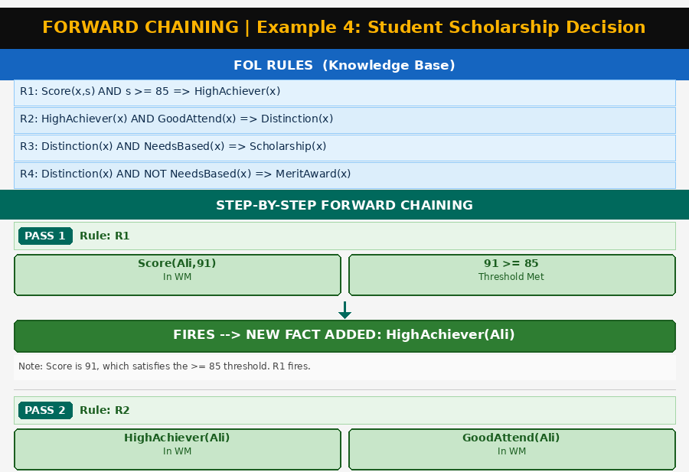
Ex 5.4 (Scholarship) — Forward Chaining Diagram (Part 1 of 2)

Slide 70
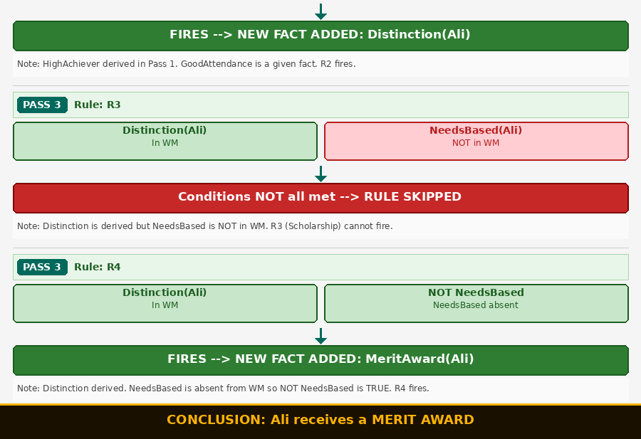
Ex 5.4 (Scholarship) — Forward Chaining Diagram (Part 2 of 2)

Slide 71
Example 5.5: Network Intrusion Detection
📋 PROBLEM STATEMENT
A network security system monitors traffic from source IP-X.
Sensors report: traffic volume is unusually high | IP-X is not in the registered database (unknown) | IP-X is scanning multiple ports | data payload contains a known malicious signature
Security policy: high traffic + unknown IP → suspicious. suspicious + port scan → attacker. attacker + malicious payload → active threat. active threat → block and alert.
Artificial Intelligence | Logical Inference, Forward & Backward Chaining

Slide 72
Ex 5.5 (Network) — Step 1: Extract Facts & Rules
Item
Type
Reason for Classification
IP-X has high traffic
FACT
Specific real-time sensor reading about this IP. Observed data point.
IP-X is an unknown IP
FACT
A lookup result about this specific IP. Concrete fact.
IP-X is doing port scanning
FACT
Detected behavior of this specific IP. Observed and verified.
IP-X has a malicious payload
FACT
Sensor result about this specific IP's data. Direct observation.
IF HighTraffic AND UnknownIP THEN SuspiciousSource
RULE
General security policy for any source. Uses variable s.
IF SuspiciousSource AND PortScan THEN Attacker
RULE
General threat escalation rule for any suspicious source.
IF Attacker AND MaliciousPayload THEN ActiveThreat
RULE
General rule for any attacker with payload evidence.
IF ActiveThreat THEN BlockAndAlert
RULE
General response protocol for any confirmed active threat.
Artificial Intelligence | Logical Inference, Forward & Backward Chaining

Slide 73
Ex 5.5 (Network) — Step 2: FOL Representation
FOL Rules
Facts & Initial WM
R1: ∀s HighTraffic(s) ∧ UnknownIP(s)
→ SuspiciousSource(s)
R2: ∀s SuspiciousSource(s) ∧ PortScan(s)
→ Attacker(s)
R3: ∀s Attacker(s) ∧ MaliciousPayload(s)
→ ActiveThreat(s)
R4: ∀s ActiveThreat(s)
→ BlockAndAlert(s)
F1: HighTraffic(IP-X)
F2: UnknownIP(IP-X)
F3: PortScan(IP-X)
F4: MaliciousPayload(IP-X)
Initial WM:
{ HighTraffic, UnknownIP,
PortScan, MaliciousPayload }
Artificial Intelligence | Logical Inference, Forward & Backward Chaining

Slide 74
Ex 5.5 (Network) — Forward Chaining Trace
Pass 1
Check R1
R1: HighTraffic(IP-X) ✓ UnknownIP(IP-X) ✓
R1 FIRES. → SuspiciousSource(IP-X) added.
Pass 2
Check R2
R2: SuspiciousSource(IP-X) ✓ (derived) PortScan(IP-X) ✓
R2 FIRES. → Attacker(IP-X) added.
Pass 3
Check R3
R3: Attacker(IP-X) ✓ (derived) MaliciousPayload(IP-X) ✓
R3 FIRES. → ActiveThreat(IP-X) added.
Pass 4
Check R4
R4: ActiveThreat(IP-X) ✓ (derived)
R4 FIRES. → BlockAndAlert(IP-X) added.
Artificial Intelligence | Logical Inference, Forward & Backward Chaining

Slide 75
Ex 5.5 (Network) — Forward Chaining Trace
Pass 5
Fixpoint
All four rules have fired. No rule uses BlockAndAlert as a condition.
FIXPOINT REACHED. STOP.
Artificial Intelligence | Logical Inference, Forward & Backward Chaining

Slide 76
Ex 5.5 (Network) — Conclusion
✅ CONCLUSION
IP-X is BLOCKED and an alert is sent.
Complete 4-rule chain:
HighTraffic + UnknownIP → SuspiciousSource (R1)
SuspiciousSource + PortScan → Attacker (R2)
Attacker + MaliciousPayload → ActiveThreat (R3)
ActiveThreat → BlockAndAlert (R4)
Every rule in the Knowledge Base contributed. This is a COMPLETE forward chain.
Artificial Intelligence | Logical Inference, Forward & Backward Chaining

Slide 77
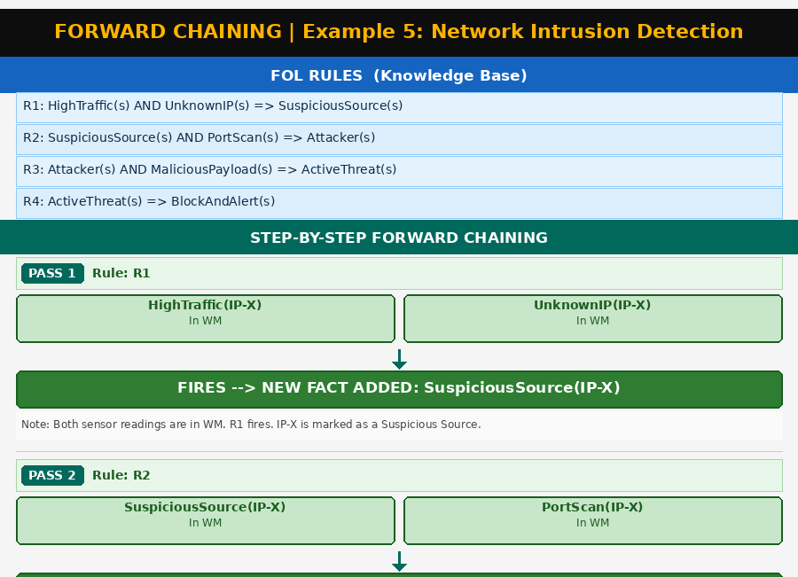
Ex 5.5 (Network) — Forward Chaining Diagram (Part 1 of 2)

Slide 78
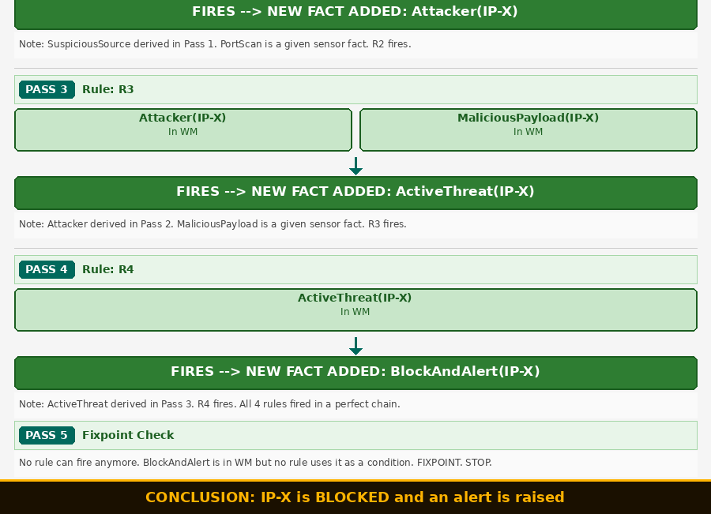
Ex 5.5 (Network) — Forward Chaining Diagram (Part 2 of 2)

Slide 79
Section 6
Backward Chaining
Goal-Driven Reasoning • 5 Full Examples
Artificial Intelligence | Logical Inference, Forward & Backward Chaining

Slide 80
Backward Chaining: Definition & Algorithm
DEFINITION — Backward Chaining
Starts with a GOAL (the conclusion we want to prove) and works BACKWARDS to find whether the facts support it. It asks: "In order to prove this goal, what conditions do I need? Can I prove those conditions?" It is goal-driven — only explores rules relevant to the goal.
SET GOAL
PUSH SUB-GOALS
1
4
Take the top-level question/goal and place it on the goal stack.
Take all CONDITIONS of that matching rule and push them as new sub-goals.
CHECK WM
RECURSE
2
5
Is the current goal already a known fact? If YES → PROVED. Move to next sub-goal.
Go back to Step 2 for each sub-goal. Sub-goals may generate their own sub-goals.
FIND RULE
CONCLUDE
3
6
Search the KB for any rule whose HEAD matches the current goal.
All sub-goals proved → goal PROVED. No rule found AND not a fact → goal FAILS.
Artificial Intelligence | Logical Inference, Forward & Backward Chaining

Slide 81
Forward vs Backward Chaining: Key Insight
⚡ Forward Chaining
🎯 Backward Chaining
Start: ALL known facts in WM
Strategy: Fire all applicable rules
Direction: Data → Conclusions
Asks: "What can I discover?"
Like: A doctor running all possible tests
Use: When you want ALL possible conclusions
Stops at: Fixpoint (no new facts)
Start: ONE specific goal
Strategy: Find rules with head = goal
Direction: Goal → Required conditions
Asks: "Can I prove THIS specific thing?"
Like: A lawyer proving one specific case
Use: When you have ONE question to answer
Stops at: Goal proved or goal fails
SAME Knowledge Base. SAME Facts. SAME Rules. The only difference is the DIRECTION of reasoning.
Artificial Intelligence | Logical Inference, Forward & Backward Chaining

Slide 82
Example 6.1: Animal Classification
📋 PROBLEM STATEMENT
We observe an animal that has fur, gives milk, and has stripes.
GOAL QUESTION: "Is this animal a Tiger?"
Use backward chaining to prove or disprove this goal.
Artificial Intelligence | Logical Inference, Forward & Backward Chaining

Slide 83
Ex 6.1 (Animal (Backward)) — FOL Representation
FOL Rules
Facts & Goal
R1: ∀x HasFur(x) ∧ GivesMilk(x)
→ Mammal(x)
R2: ∀x Mammal(x) ∧ HasStripes(x)
→ Tiger(x)
F1: HasFur(animal)
F2: GivesMilk(animal)
F3: HasStripes(animal)
WM: { HasFur, GivesMilk, HasStripes }
GOAL: PROVE Tiger(animal)
Artificial Intelligence | Logical Inference, Forward & Backward Chaining

Slide 84
Ex 6.1 (Animal) — Backward Chaining Trace
Step 1
Goal: Tiger(x)
Is Tiger(x) in WM? NO.
Search KB for HEAD = Tiger(x). Found R2.
PUSH SUB-GOALS: [ Mammal(x), HasStripes(x) ]
Step 2
Sub-Goal: Mammal(x)
Is Mammal(x) in WM? NO.
Search KB for HEAD = Mammal(x). Found R1.
PUSH SUB-GOALS: [ HasFur(x), GivesMilk(x) ]
Step 3
Sub-Goal: HasFur(x)
Is HasFur(x) in WM? YES ✓
PROVED directly from facts.
Step 4
Sub-Goal: GivesMilk(x)
Is GivesMilk(x) in WM? YES ✓
PROVED directly from facts.
Artificial Intelligence | Logical Inference, Forward & Backward Chaining

Slide 85
Ex 6.1 (Animal) — Backward Chaining Trace
Step 5
Return: Mammal(x)
Both conditions of R1 proved: HasFur ✓ GivesMilk ✓
R1 fires. MAMMAL(x) is PROVED. ✓
Step 6
Sub-Goal: HasStripes(x)
Is HasStripes(x) in WM? YES ✓
PROVED directly from facts.
Step 7
Return: Tiger(x)
Both conditions of R2 proved: Mammal ✓ HasStripes ✓
R2 fires. TIGER(x) is PROVED. ✓
Artificial Intelligence | Logical Inference, Forward & Backward Chaining

Slide 86
Ex 6.1 (Animal) — Conclusion
✅ GOAL PROVED
YES — the animal is confirmed to be a TIGER.
Backward chain:
Goal: Tiger(x) ← R2 ← [ Mammal(x), HasStripes(x) ]
Sub-Goal Mammal(x) ← R1 ← [ HasFur ✓, GivesMilk ✓ ]
HasStripes ✓ (found directly in WM)
Artificial Intelligence | Logical Inference, Forward & Backward Chaining

Slide 87
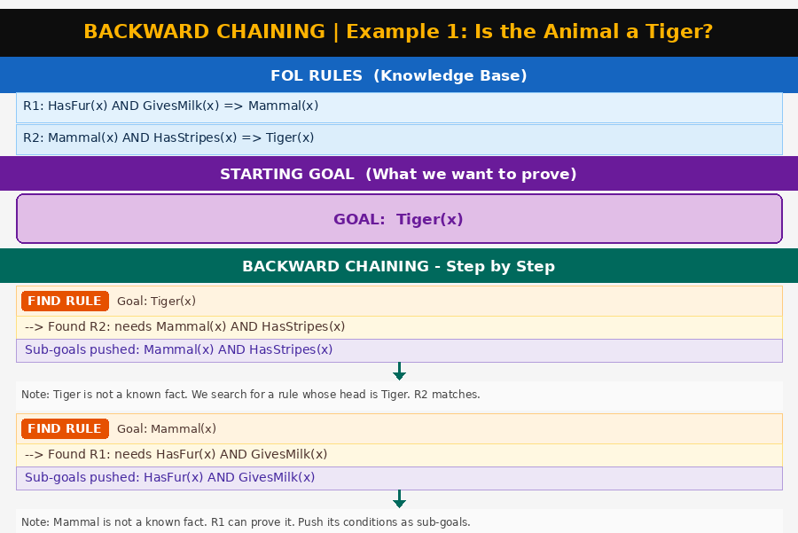
Ex 6.1 (Animal) — Backward Chaining Diagram (Part 1 of 2)

Slide 88
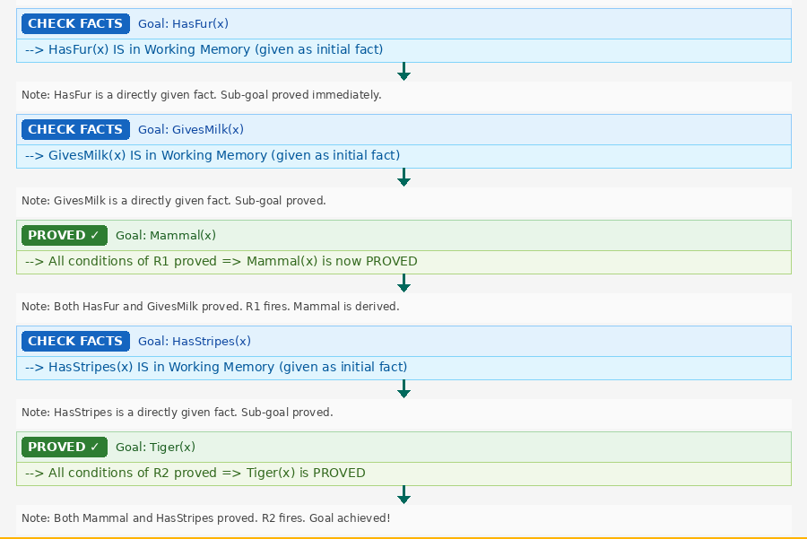
Ex 6.1 (Animal) — Backward Chaining Diagram (Part 2 of 2)
Artificial Intelligence | Logical Inference, Forward & Backward Chaining

Slide 89
Example 6.2: Loan Eligibility
📋 PROBLEM STATEMENT
A bank AI system receives a query: "Is Ahmed's loan approved?"
Known facts: Ahmed is employed | Ahmed is 25 years old (over 21) | Ahmed has a good credit score
Bank policy: any employed person over 21 is basically eligible. Any basically eligible person with good credit gets their loan approved.
Artificial Intelligence | Logical Inference, Forward & Backward Chaining

Slide 90
Ex 6.2 (Loan (Backward)) — FOL Representation
FOL Rules
Facts & Goal
R1: ∀x Employed(x) ∧ AgeOver21(x)
→ BasicEligible(x)
R2: ∀x BasicEligible(x) ∧ GoodCredit(x)
→ LoanApproved(x)
F1: Employed(Ahmed)
F2: AgeOver21(Ahmed)
F3: GoodCredit(Ahmed)
WM: { Employed, AgeOver21, GoodCredit }
GOAL: PROVE LoanApproved(Ahmed)
Artificial Intelligence | Logical Inference, Forward & Backward Chaining

Slide 91
Ex 6.2 (Loan) — Backward Chaining Trace
Step 1
Goal: LoanApproved
Is LoanApproved in WM? NO.
Found R2. Conditions: BasicEligible(Ahmed) AND GoodCredit(Ahmed).
PUSH SUB-GOALS: [ BasicEligible(Ahmed), GoodCredit(Ahmed) ]
Step 2
Sub-Goal: BasicEligible
Is BasicEligible in WM? NO.
Found R1. Conditions: Employed(Ahmed) AND AgeOver21(Ahmed).
PUSH SUB-GOALS: [ Employed(Ahmed), AgeOver21(Ahmed) ]
Step 3
Employed(Ahmed)
Is Employed(Ahmed) in WM? YES ✓
PROVED directly.
Step 4
AgeOver21(Ahmed)
Is AgeOver21(Ahmed) in WM? YES ✓
PROVED directly.
Artificial Intelligence | Logical Inference, Forward & Backward Chaining

Slide 92
Ex 6.2 (Loan) — Backward Chaining Trace
Step 5
Return: BasicEligible
Both R1 conditions proved: Employed ✓ AgeOver21 ✓
R1 fires. BASICELIGIBLE(Ahmed) PROVED. ✓
Step 6
GoodCredit(Ahmed)
Is GoodCredit(Ahmed) in WM? YES ✓
PROVED directly.
Step 7
Return: LoanApproved
Both R2 conditions proved: BasicEligible ✓ GoodCredit ✓
R2 fires. LOANAPPROVED(Ahmed) PROVED. ✓
Artificial Intelligence | Logical Inference, Forward & Backward Chaining

Slide 93
Ex 6.2 (Loan) — Conclusion
✅ GOAL PROVED
YES — Ahmed's loan is APPROVED.
Backward chain:
Goal: LoanApproved(Ahmed) ← R2 ← [ BasicEligible, GoodCredit ]
Sub-Goal BasicEligible(Ahmed) ← R1 ← [ Employed ✓, AgeOver21 ✓ ]
GoodCredit directly found in WM ✓
Artificial Intelligence | Logical Inference, Forward & Backward Chaining

Slide 94
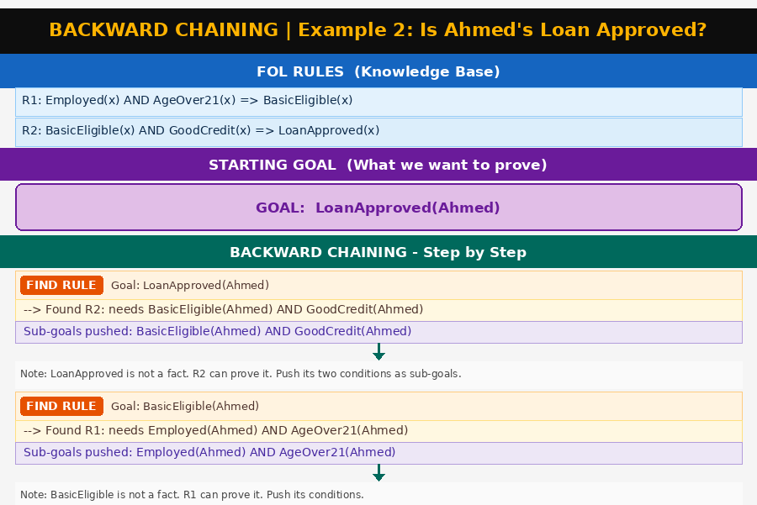
Ex 6.2 (Loan) — Backward Chaining Diagram (Part 1 of 2)

Slide 95
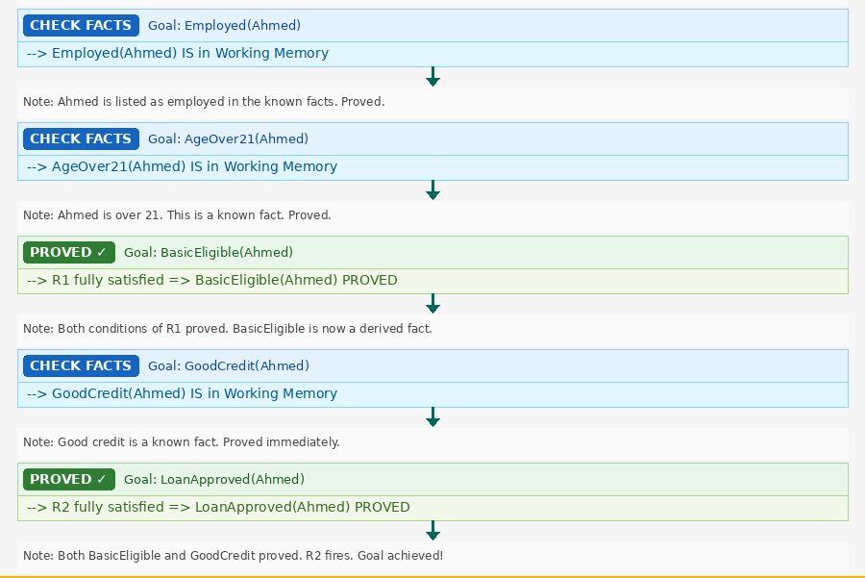
Ex 6.2 (Loan) — Backward Chaining Diagram (Part 2 of 2)
Artificial Intelligence | Logical Inference, Forward & Backward Chaining

Slide 96
Example 6.3: Medical Diagnosis
📋 PROBLEM STATEMENT
A medical system is asked: "Does Sara need antibiotics?"
Sara's record: fever | coughing | fatigue | symptoms lasted more than 3 days
Medical knowledge: fever + cough + fatigue → flu. flu + symptoms >3 days → needs antibiotics.
Artificial Intelligence | Logical Inference, Forward & Backward Chaining

Slide 97
Ex 6.3 (Medical (Backward)) — FOL Representation
FOL Rules
Facts & Goal
R1: ∀p Fever(p) ∧ Cough(p) ∧ Fatigue(p)
→ HasFlu(p)
R2: ∀p HasFlu(p) ∧ DurationOver3Days(p)
→ NeedsAntibiotics(p)
F1: Fever(Sara)
F2: Cough(Sara)
F3: Fatigue(Sara)
F4: DurationOver3Days(Sara)
WM: { Fever, Cough, Fatigue,
DurationOver3Days }
GOAL: PROVE NeedsAntibiotics(Sara)
Artificial Intelligence | Logical Inference, Forward & Backward Chaining

Slide 98
Ex 6.3 (Medical) — Backward Chaining Trace
Step 1
Goal: NeedsAntibiotics
Is NeedsAntibiotics in WM? NO.
Found R2. Conditions: HasFlu(Sara) AND DurationOver3Days(Sara).
PUSH SUB-GOALS: [ HasFlu(Sara), DurationOver3Days(Sara) ]
Step 2
Sub-Goal: HasFlu
Is HasFlu in WM? NO.
Found R1. Conditions: Fever, Cough, Fatigue.
PUSH SUB-GOALS: [ Fever(Sara), Cough(Sara), Fatigue(Sara) ]
Step 3
Fever,Cough,Fatigue
Fever(Sara) in WM? YES ✓
Cough(Sara) in WM? YES ✓
Fatigue(Sara) in WM? YES ✓
All three PROVED directly from facts.
Step 4
Return: HasFlu
All 3 conditions of R1 proved: Fever ✓ Cough ✓ Fatigue ✓
R1 fires. HASFLU(Sara) PROVED. ✓
Artificial Intelligence | Logical Inference, Forward & Backward Chaining

Slide 99
Ex 6.3 (Medical) — Backward Chaining Trace
Step 5
DurationOver3Days
Is DurationOver3Days(Sara) in WM? YES ✓
PROVED directly.
Step 6
Return: NeedsAntibiotics
Both R2 conditions proved: HasFlu ✓ DurationOver3Days ✓
R2 fires. NEEDSANTIBIOTICS(Sara) PROVED. ✓
Artificial Intelligence | Logical Inference, Forward & Backward Chaining

Slide 100
Ex 6.3 (Medical) — Conclusion
✅ GOAL PROVED
YES — Sara NEEDS ANTIBIOTICS.
Backward chain:
Goal: NeedsAntibiotics ← R2 ← [ HasFlu, DurationOver3Days ]
Sub-Goal HasFlu ← R1 ← [ Fever ✓, Cough ✓, Fatigue ✓ ]
DurationOver3Days ✓ (found directly in WM)
Note: R1 required THREE sub-goals to be proved — all found directly in WM.
Artificial Intelligence | Logical Inference, Forward & Backward Chaining

Slide 101
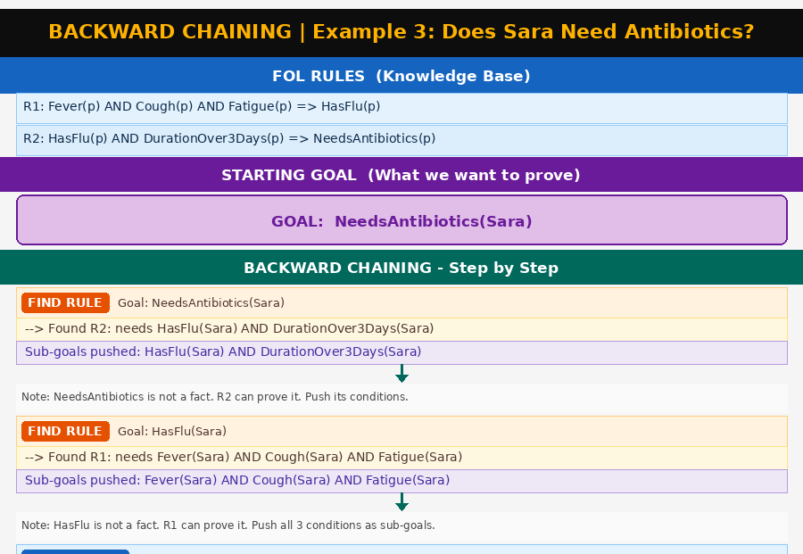
Ex 6.3 (Medical) — Backward Chaining Diagram (Part 1 of 2)
Artificial Intelligence | Logical Inference, Forward & Backward Chaining

Slide 102
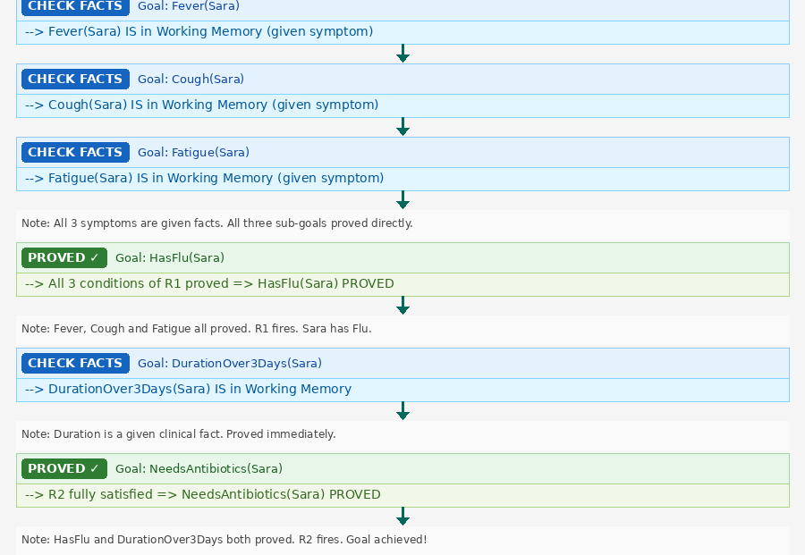
Ex 6.3 (Medical) — Backward Chaining Diagram (Part 2 of 2)
Artificial Intelligence | Logical Inference, Forward & Backward Chaining

Slide 103
Example 6.4: Scholarship Award
📋 PROBLEM STATEMENT
A university system is asked: "Is Omar a scholarship winner?"
Omar's record: scored 88 in exams | recognized as a student leader
University policy: score ≥ 80 → academic excellence. academic excellence + leader → scholarship winner.
Artificial Intelligence | Logical Inference, Forward & Backward Chaining

Slide 104
Ex 6.4 (Scholarship (Backward)) — FOL Representation
FOL Rules
Facts & Goal
R1: ∀x Score(x,s) ∧ s≥80
→ AcademicExcellence(x)
R2: ∀x AcademicExcellence(x) ∧ Leader(x)
→ ScholarshipWinner(x)
F1: Score(Omar, 88)
F2: Leader(Omar)
WM: { Score(Omar,88), Leader(Omar) }
GOAL: PROVE ScholarshipWinner(Omar)
Artificial Intelligence | Logical Inference, Forward & Backward Chaining

Slide 105
Ex 6.4 (Scholarship) — Backward Chaining Trace
Step 1
Goal: ScholarshipWinner
Is ScholarshipWinner in WM? NO.
Found R2. Conditions: AcademicExcellence(Omar) AND Leader(Omar).
PUSH SUB-GOALS: [ AcademicExcellence(Omar), Leader(Omar) ]
Step 2
Sub-Goal: AcademicExcellence
Is AcademicExcellence in WM? NO.
Found R1. Conditions: Score(Omar,s) AND s≥80.
PUSH SUB-GOALS: [ Score(Omar,88), 88≥80 ]
Step 3
Score(Omar,88)
Is Score(Omar,88) in WM? YES ✓
PROVED directly from facts.
Step 4
88 ≥ 80
Arithmetic check: 88 ≥ 80 → TRUE ✓
PROVED by numerical verification.
Artificial Intelligence | Logical Inference, Forward & Backward Chaining

Slide 106
Ex 6.4 (Scholarship) — Backward Chaining Trace
Step 5
Return: AcademicExcellence
Both R1 conditions proved: Score ✓ Threshold 88≥80 ✓
R1 fires. ACADEMICEXCELLENCE(Omar) PROVED. ✓
Step 6
Leader(Omar)
Is Leader(Omar) in WM? YES ✓
PROVED directly.
Step 7
Return: ScholarshipWinner
Both R2 conditions proved: AcademicExcellence ✓ Leader ✓
R2 fires. SCHOLARSHIPWINNER(Omar) PROVED. ✓
Artificial Intelligence | Logical Inference, Forward & Backward Chaining

Slide 107
Ex 6.4 (Scholarship) — Conclusion
✅ GOAL PROVED
YES — Omar WINS the scholarship.
Backward chain:
Goal: ScholarshipWinner ← R2 ← [ AcademicExcellence, Leader ]
Sub-Goal AcademicExcellence ← R1 ← [ Score(88) ✓, 88≥80 ✓ ]
Leader ✓ (found directly in WM)
Note: The arithmetic check (88≥80) is a SPECIAL TYPE of sub-goal — proved by computation, not by finding it in WM.
Artificial Intelligence | Logical Inference, Forward & Backward Chaining

Slide 108
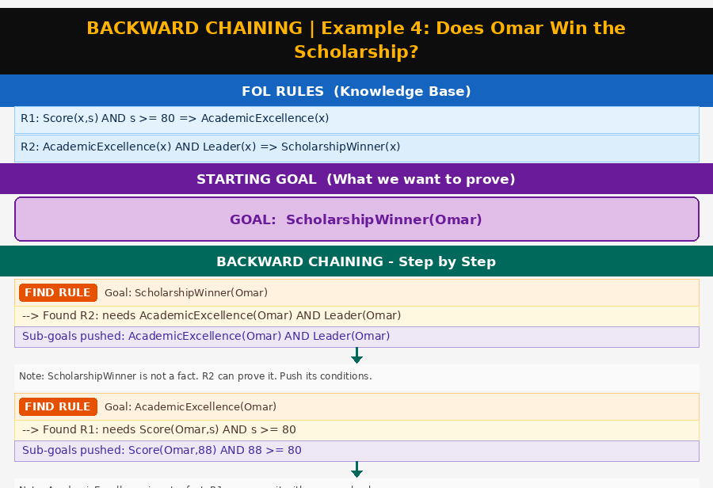
Ex 6.4 (Scholarship) — Backward Chaining Diagram (Part 1 of 2)
Artificial Intelligence | Logical Inference, Forward & Backward Chaining

Slide 109
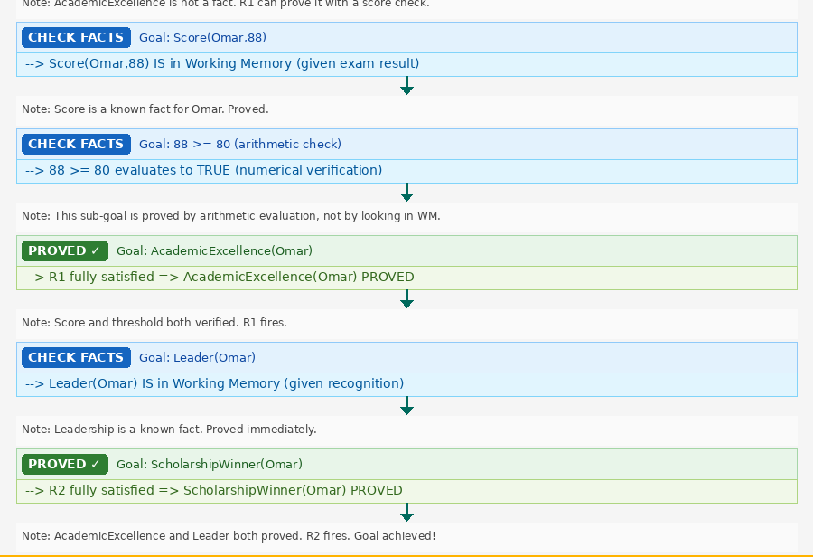
Ex 6.4 (Scholarship) — Backward Chaining Diagram (Part 2 of 2)
Artificial Intelligence | Logical Inference, Forward & Backward Chaining

Slide 110
Example 6.5: Device Troubleshooting (GOAL FAILS)
📋 PROBLEM STATEMENT
A device management system is asked: "Does Device1 need an OS reinstall?"
Known facts: Device1 is powered on | Device1 has error logs with warning messages
MISSING: NO crash loop has been observed for Device1
Technical knowledge: device ON + crash loop → software fault. software fault + error logs → OS reinstall needed.
Artificial Intelligence | Logical Inference, Forward & Backward Chaining

Slide 111
Ex 6.5 (Device (Backward)) — FOL Representation
FOL Rules
Facts & Goal
R1: ∀d DeviceOn(d) ∧ CrashLoop(d)
→ SoftwareFault(d)
R2: ∀d SoftwareFault(d) ∧ LogError(d)
→ NeedsOSReinstall(d)
F1: DeviceOn(Device1)
F2: LogError(Device1)
MISSING: CrashLoop(Device1)
not in WM, no rule derives it
WM: { DeviceOn, LogError }
GOAL: PROVE NeedsOSReinstall
Artificial Intelligence | Logical Inference, Forward & Backward Chaining

Slide 112
Ex 6.5 (Device) — Backward Chaining Trace
Step 1
Goal: NeedsOSReinstall
Is NeedsOSReinstall in WM? NO.
Found R2. Conditions: SoftwareFault(Device1) AND LogError(Device1).
PUSH SUB-GOALS: [ SoftwareFault(Device1), LogError(Device1) ]
Step 2
Sub-Goal: SoftwareFault
Is SoftwareFault in WM? NO.
Found R1. Conditions: DeviceOn(Device1) AND CrashLoop(Device1).
PUSH SUB-GOALS: [ DeviceOn(Device1), CrashLoop(Device1) ]
Step 3
DeviceOn(Device1)
Is DeviceOn(Device1) in WM? YES ✓
PROVED directly.
Step 4
CrashLoop(Device1)
Is CrashLoop(Device1) in WM? NO ✗
Search KB for any rule with HEAD = CrashLoop... NONE FOUND.
CRASHLOOP SUB-GOAL FAILS ✗
Artificial Intelligence | Logical Inference, Forward & Backward Chaining

Slide 113
Ex 6.5 (Device) — Backward Chaining Trace
Step 5
Propagate Failure
CrashLoop FAILED → R1 cannot fire → SoftwareFault FAILS ✗
SoftwareFault FAILED → R2 cannot fire → NeedsOSReinstall FAILS ✗
Failure propagates all the way up the goal tree.
Artificial Intelligence | Logical Inference, Forward & Backward Chaining

Slide 114
Ex 6.5 (Device) — Conclusion
❌ GOAL FAILED
NO — we CANNOT conclude that Device1 needs an OS reinstall. GOAL FAILED.
The chain broke at: CrashLoop(Device1) — not in WM, and no rule can derive it.
Failure propagation:
CrashLoop FAILED → SoftwareFault FAILED → NeedsOSReinstall FAILED
Important Lesson: A FAILED GOAL is useful information! It tells us EXACTLY what evidence is missing. A technician should check whether Device1 is actually in a crash loop.
Artificial Intelligence | Logical Inference, Forward & Backward Chaining

Slide 115
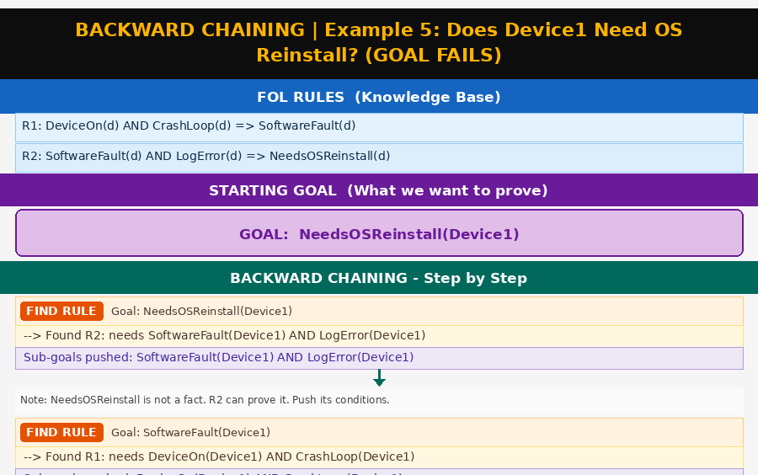
Ex 6.5 (Device) — Backward Chaining Diagram (Part 1 of 2)
Artificial Intelligence | Logical Inference, Forward & Backward Chaining

Slide 116
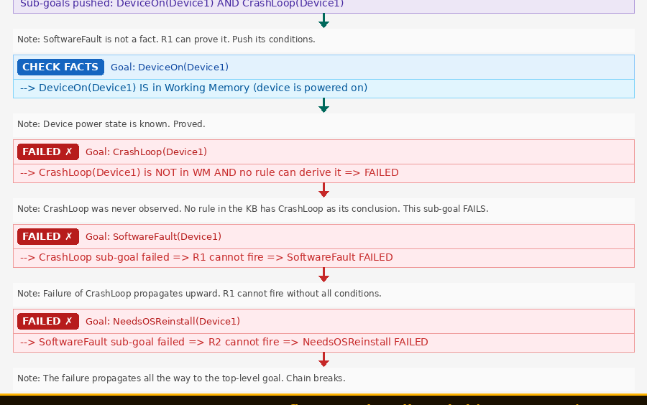
Ex 6.5 (Device) — Backward Chaining Diagram (Part 2 of 2)

